Slide 1

Advanced Data Analytics
Course Project
Study Smarter: Data-Driven Insights into Student Performance
Team Member 1 Abhishek P, SRN PES2UG23AM002
Team Member 2 Adyaa GB , SRN PES2UG23AM006
Team Member 3 Adyanth S , SRN PES2UG23AM007
Team Member 4 Harsha , SRN PES2UG23AM042

Slide 2

Submission Checklist
Advanced Data Analytics
No | Feature Description | Drive Shared ( Y/N)
1 | Code notebook | Y
2 | Dataset or dataset source | Y
3 | This PPT | Y
4 | The 5 mins Video presenting your paper | Y
5 | Brief Project Report in IEEE Format | Y
Note: Mention the email-ids you shared the drive with ( your course TAs and your faculty)

Slide 3
Problem Statement
Advanced Data Analytics
Define your problem statement crisply
Our project tackles student performance using a two-part approach:
Prediction: To develop and evaluate regression models (e.g., Random Forest, Lasso) to predict a student's final academic grade (G3) based on their demographic, social, and academic background .
Causal Inference: To move beyond correlation and determine the true causal impact of "high study time" (defined as 2 or more hours) on final grades, while controlling for confounding variables like past failures and absences .

Slide 4
Uniqueness
Advanced Data Analytics
Why is this topic unique? Write in crisp bullets
This topic is unique for the following reasons:
Dual-Pronged Analysis: The project integrates two distinct data science domains: traditional predictive modeling (what will the grade be?) and formal causal inference (does studying cause a better grade?).
Robust Causal Methods: Instead of just looking at correlations, we use robust methods like Propensity Score Matching (PSM) and Inverse Probability Weighting (IPW) to isolate the true effect of studying from confounding factors .
Heterogeneity Analysis: We provide nuanced insights by investigating how the causal effect of studying differs across subgroups, specifically by gender and the number of past academic failures .
Combined Dataset: We create a more robust sample for analysis by merging two separate UCI datasets (Mathematics and Portuguese) to achieve a total sample size of 1044 students .

Slide 5
Dataset
Advanced Data Analytics
Size, attribute, source
Details on the dataset used for this analysis:
Source: Merged "Student Performance" dataset (P. Cortez and A. Silva) from two secondary school courses: Mathematics and Portuguese language .
Size: 1044 observations (students) and 33 original attributes (features) .
Attributes: A rich mix of features, including:
  Academic: G1, G2, G3 (grades), studytime, failures, absences
  Demographic: age, sex, address, Mjob, Fjob
  Social/Lifestyle: freetime, goout, Dalc (workday alcohol), Walc (weekend alcohol), health

Slide 6
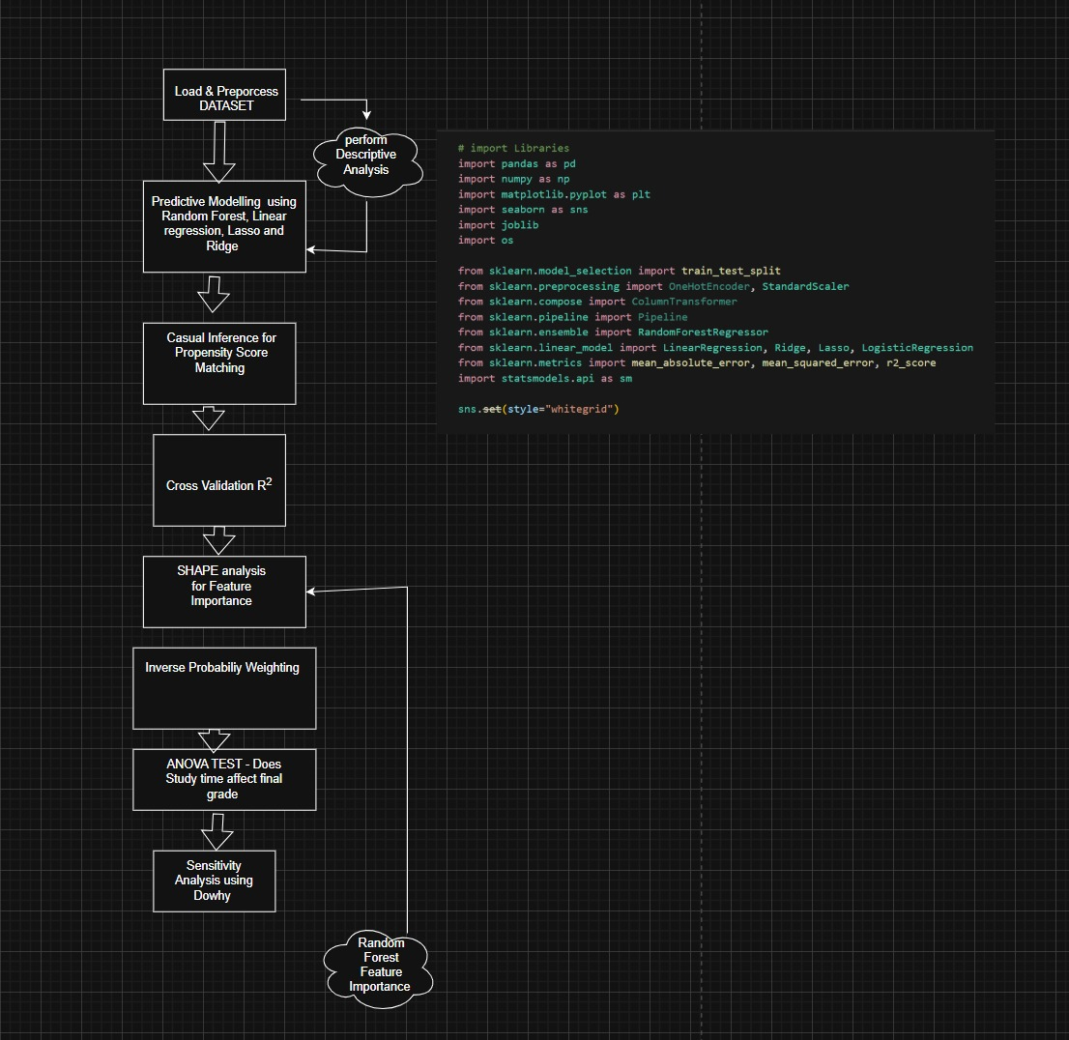
Overall Design or Approach
Advanced Data Analytics

Slide 7
Final Results
Advanced Data Analytics
Predictive Model Metrics
The goal was to predict the final grade, G3 (a score from 0-20).
Best Model: Random Forest Regressor .
Test Set R²: 0.178
Test Set RMSE: 3.491
Cross-Validation (Avg. R²): 0.123 . (This low score indicates that predicting the exact grade is very difficult, likely due to high human variability).
Causal Inference Findings
We estimated the causal effect of "High Study Time" (>= 2 hours) on G3.
Average Treatment Effect (ATE): Both PSM and IPW confirm a positive and statistically significant causal effect .
Finding: High study time causes an average increase of 0.56 points in the final grade (G3), after controlling for confounders (IPW, p=0.017) .

Slide 8
Final Results
Advanced Data Analytics
Key Visualizations
SHAP Feature Importance: This plot shows the biggest drivers for the Random Forest model's predictions.
  absences and failures are the most significant negative factors.
  high_study (our treatment variable) is confirmed as a positive driver.
  Propensity Score Overlap: This plot confirms that the "High Study" (Treated) and "Low Study" (Control) groups were similar enough (good overlap) to conduct a valid causal analysis.

Slide 9
Features : Done vs. Remaining to be done
Advanced Data Analytics
No | Description | Done or To be Done ?
1 | Predictive Modeling (4 models) | Done
2 | Causal Inference (PSM & IPW) | Done
3 | Model Validation (CV) & SHAP | Done
4 | Heterogeneity Subgroup Analysis | Done
5 | Model Tuning | To be Done
 | Causal Sensitivity Analysis | Done
 | Test on new data | Done

Slide 10
Features : Who did what
Advanced Data Analytics
No | Feature Description | Contributed By
1 | Data Cleaning & EDA | Adyanth S, Adyaa G B, Harsha
2 | Predictive Modelling | Abhishek P, Harsha, Adyaa G B
3 | Causal Inference & PSM/IPW | Adyanth S, Abhishek P
4 | Validation & SHAP Analysis | Adyanth S
5 | Subgroup Analysis & PPT | Adyaa G B

Slide 11
Quantity and Quality of Work
Advanced Data Analytics
No | Code Functionality | % Complete | Runs w/o Issues ( Y /N) | State minor issues
1. | Data Loading & Cleaning | 100% | Y | None
2. | Descriptive Analysis | 100% | Y | None
3. | Predictive Modelling | 100% | Y | Code runs perfectly. Predictive R² is low (0.178) , but this is a finding, not a code issue.
4. | Causal Inference | 100% | Y | None.
5. | Validation & SHAP | 100% | Y | Cross-validation scores show high variance , suggesting the model is not very stable.

Slide 12
Top Few Learnings from this Project
Advanced Data Analytics
No | Description
1 | Causation > Correlation: We proved "high study time" causes a ~0.56 point grade increase, a finding simple correlation cannot provide .
2 | Subgroup Effects are Crucial: It is statistically significant for Male students (causing a +0.87 point increase, p=0.013) but not for Female students (p=0.266) .
3 | Targeted Intervention Insight: The impact of study time is strongest for students who have previously failed 2 courses (a +3.38 point increase, p=0.031).
4 | Prediction vs. Inference: Predicting an exact grade (G3) is very difficult (low R²), likely due to high human variability.
5 | Model Validation is Key: The initial test R² (0.178) looked low, but 5-fold cross-validation (Avg. R²=0.123) confirmed the model's high variance and limited predictive power, preventing us from overstating its capability .

Slide 13
Top Unresolved Challenges
Advanced Data Analytics
No | Description
1 | Low Predictive Power: The best regression model (Random Forest) had a very low R² (0.178 on test, 0.123 on CV) . This means the current features are insufficient to accurately predict a student's exact final grade.
2 | High Model Variance: Inconsistent cross-validation scores (-0.42 to 0.34) show the Random Forest model is unstable.
3 | Confounding Variables: Causal estimates are sensitive to unmeasured factors (like motivation)
4 | Small Subgroup Samples: Analyses by failures are unreliable because the sample sizes (e.g., N=30) are too small

Slide 14
References, if any
Advanced Data Analytics
No | Paper title | Year of publication
1 | (Dataset) Using Data Mining to Predict Secondary School Student Performance. (P. Cortez and A. Silva) | 2008
2 | Department of Computer Science, [University Name], “Bangladesh Secondary School Student Performance Dataset,” | 2025
3 | Sharma, A., Kallus, N., Song, X., & Xu, Z. (2020). DoWhy: An end-to-end library for causal inference. arXiv preprint arXiv:2011.04216. | 2020
4 | S. Seabold and J. Perktold, “Statsmodels: Econometric and statistical modeling with Python,” in Proc. 9th Python in Science Conf., 2010. | 2010
5 | J. M. Robins, M. A. Hernán, and B. Brumback, “Marginal structural models and causal inference in epidemiology,” Epidemiology, vol. 11, | 2000
6 | A. Sharma, N. Kallus, X. Song, and Z. Xu, “DoWhy: An end-to-end library for causal inference,” arXiv preprint arXiv:2011.04216, 2020. | 2020
7 | S. M. Lundberg and S.-I. Lee, “A unified approach to interpreting model predictions,” in Advances in Neural Information Processing Systems (NeurIPS), vol. 30, | 2017

Slide 15

THANK YOU
November 2025
Department of Computer Science and Engineering in AI &ML

